Slide 1
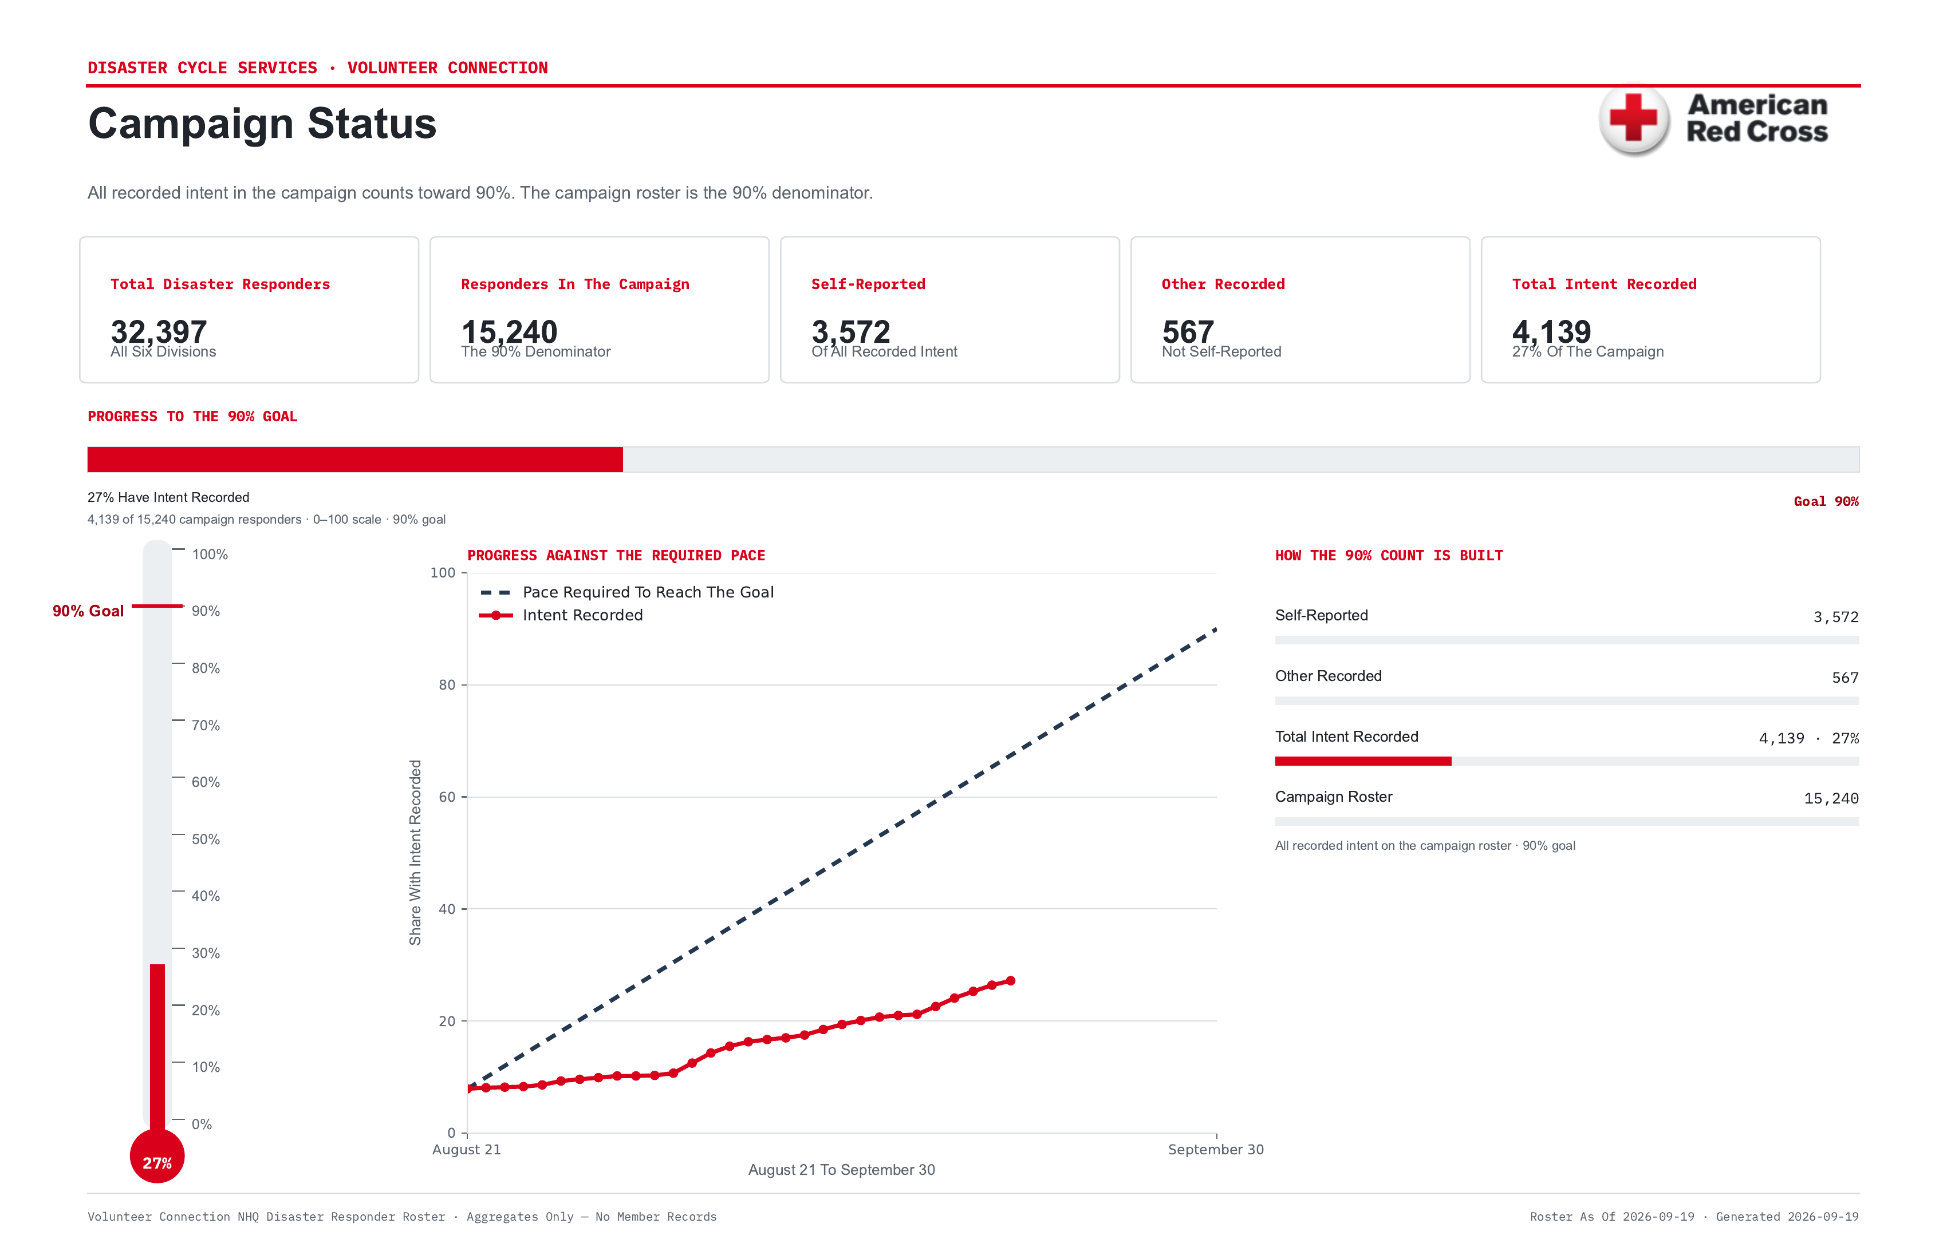
Where The Campaign Stands
Notes:
The 90% goal is all recorded intent counted against the campaign roster: 4,139 of 15,240 campaign responders (27%). Of those, 3,572 self-reported and 567 had it recorded another way. The campaign roster is the 90% denominator, not the 32,397 disaster responders in the national file. The dashed line is the pace required to get to 90% by September 30.

Slide 2
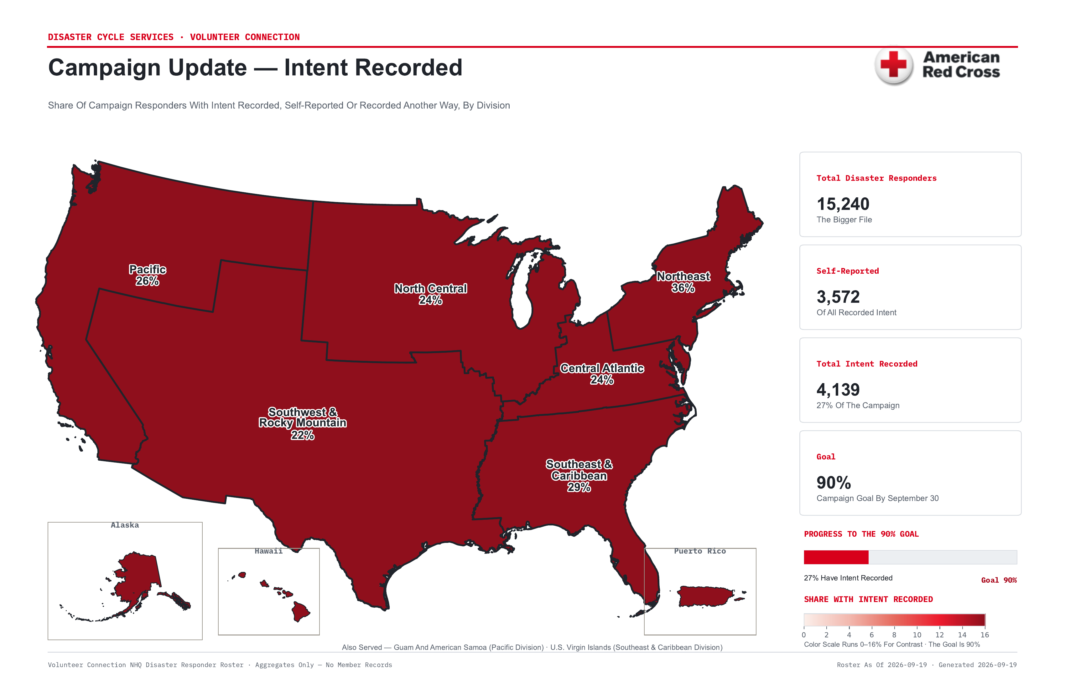
Divisions
Notes:
Every division, shaded by the share of its target responders who entered their own intent. The color scale runs zero to sixteen percent so the differences are visible; the goal is ninety. No division is close yet, so this is about who is moving, not who has arrived.

Slide 3
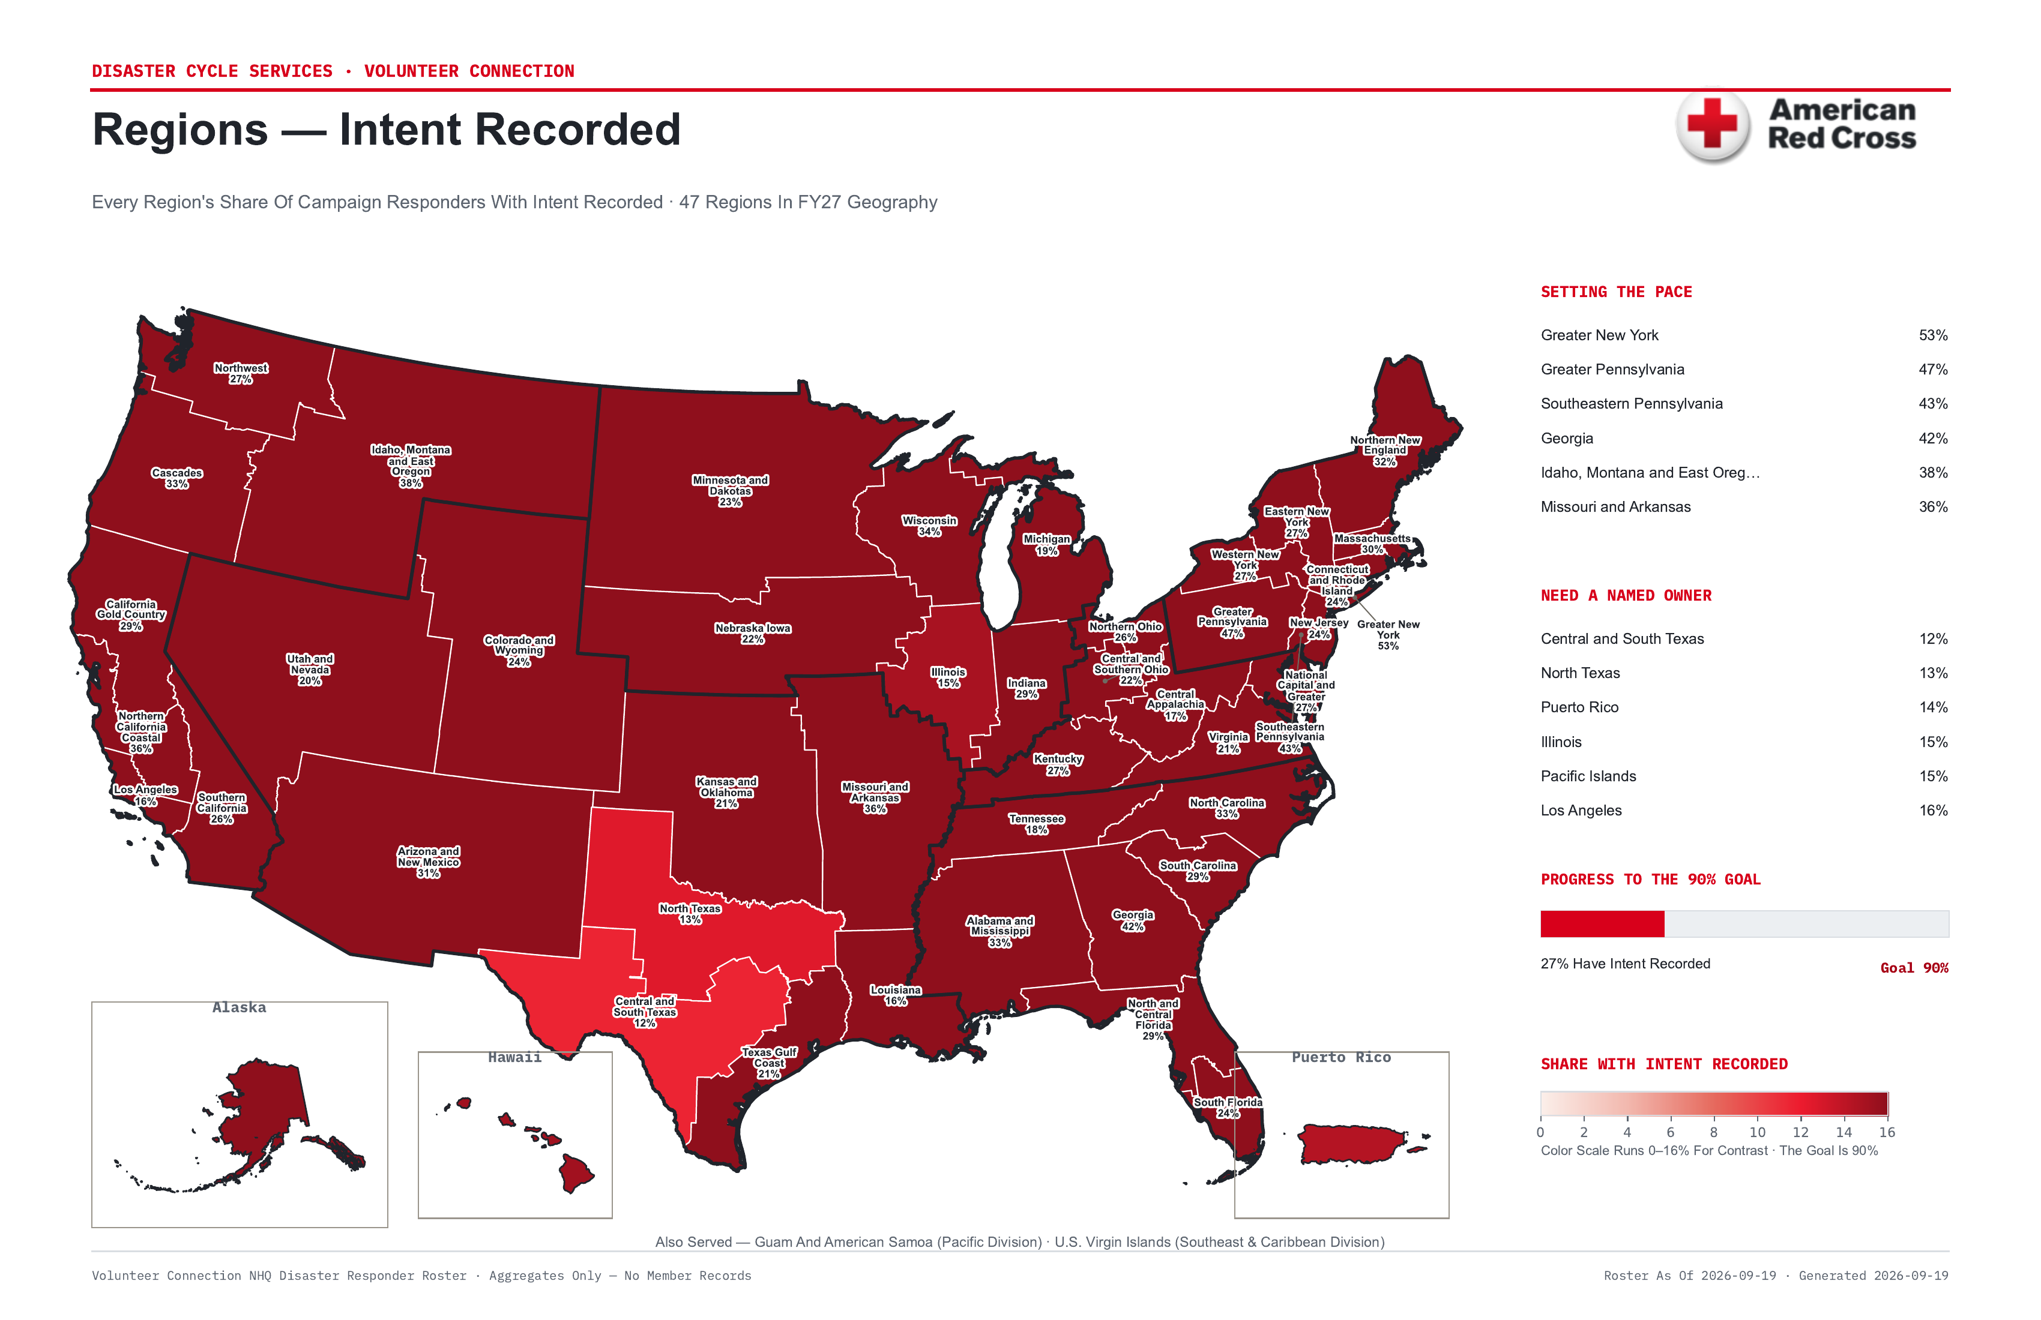
Regions
Notes:
The same measure at region level, which is where a named owner can actually be held to a number. Northern New England leads at 20.5%. The regions listed under Need A Named Owner are the ones with no visible movement — that list is the ask coming out of this meeting.

Slide 4
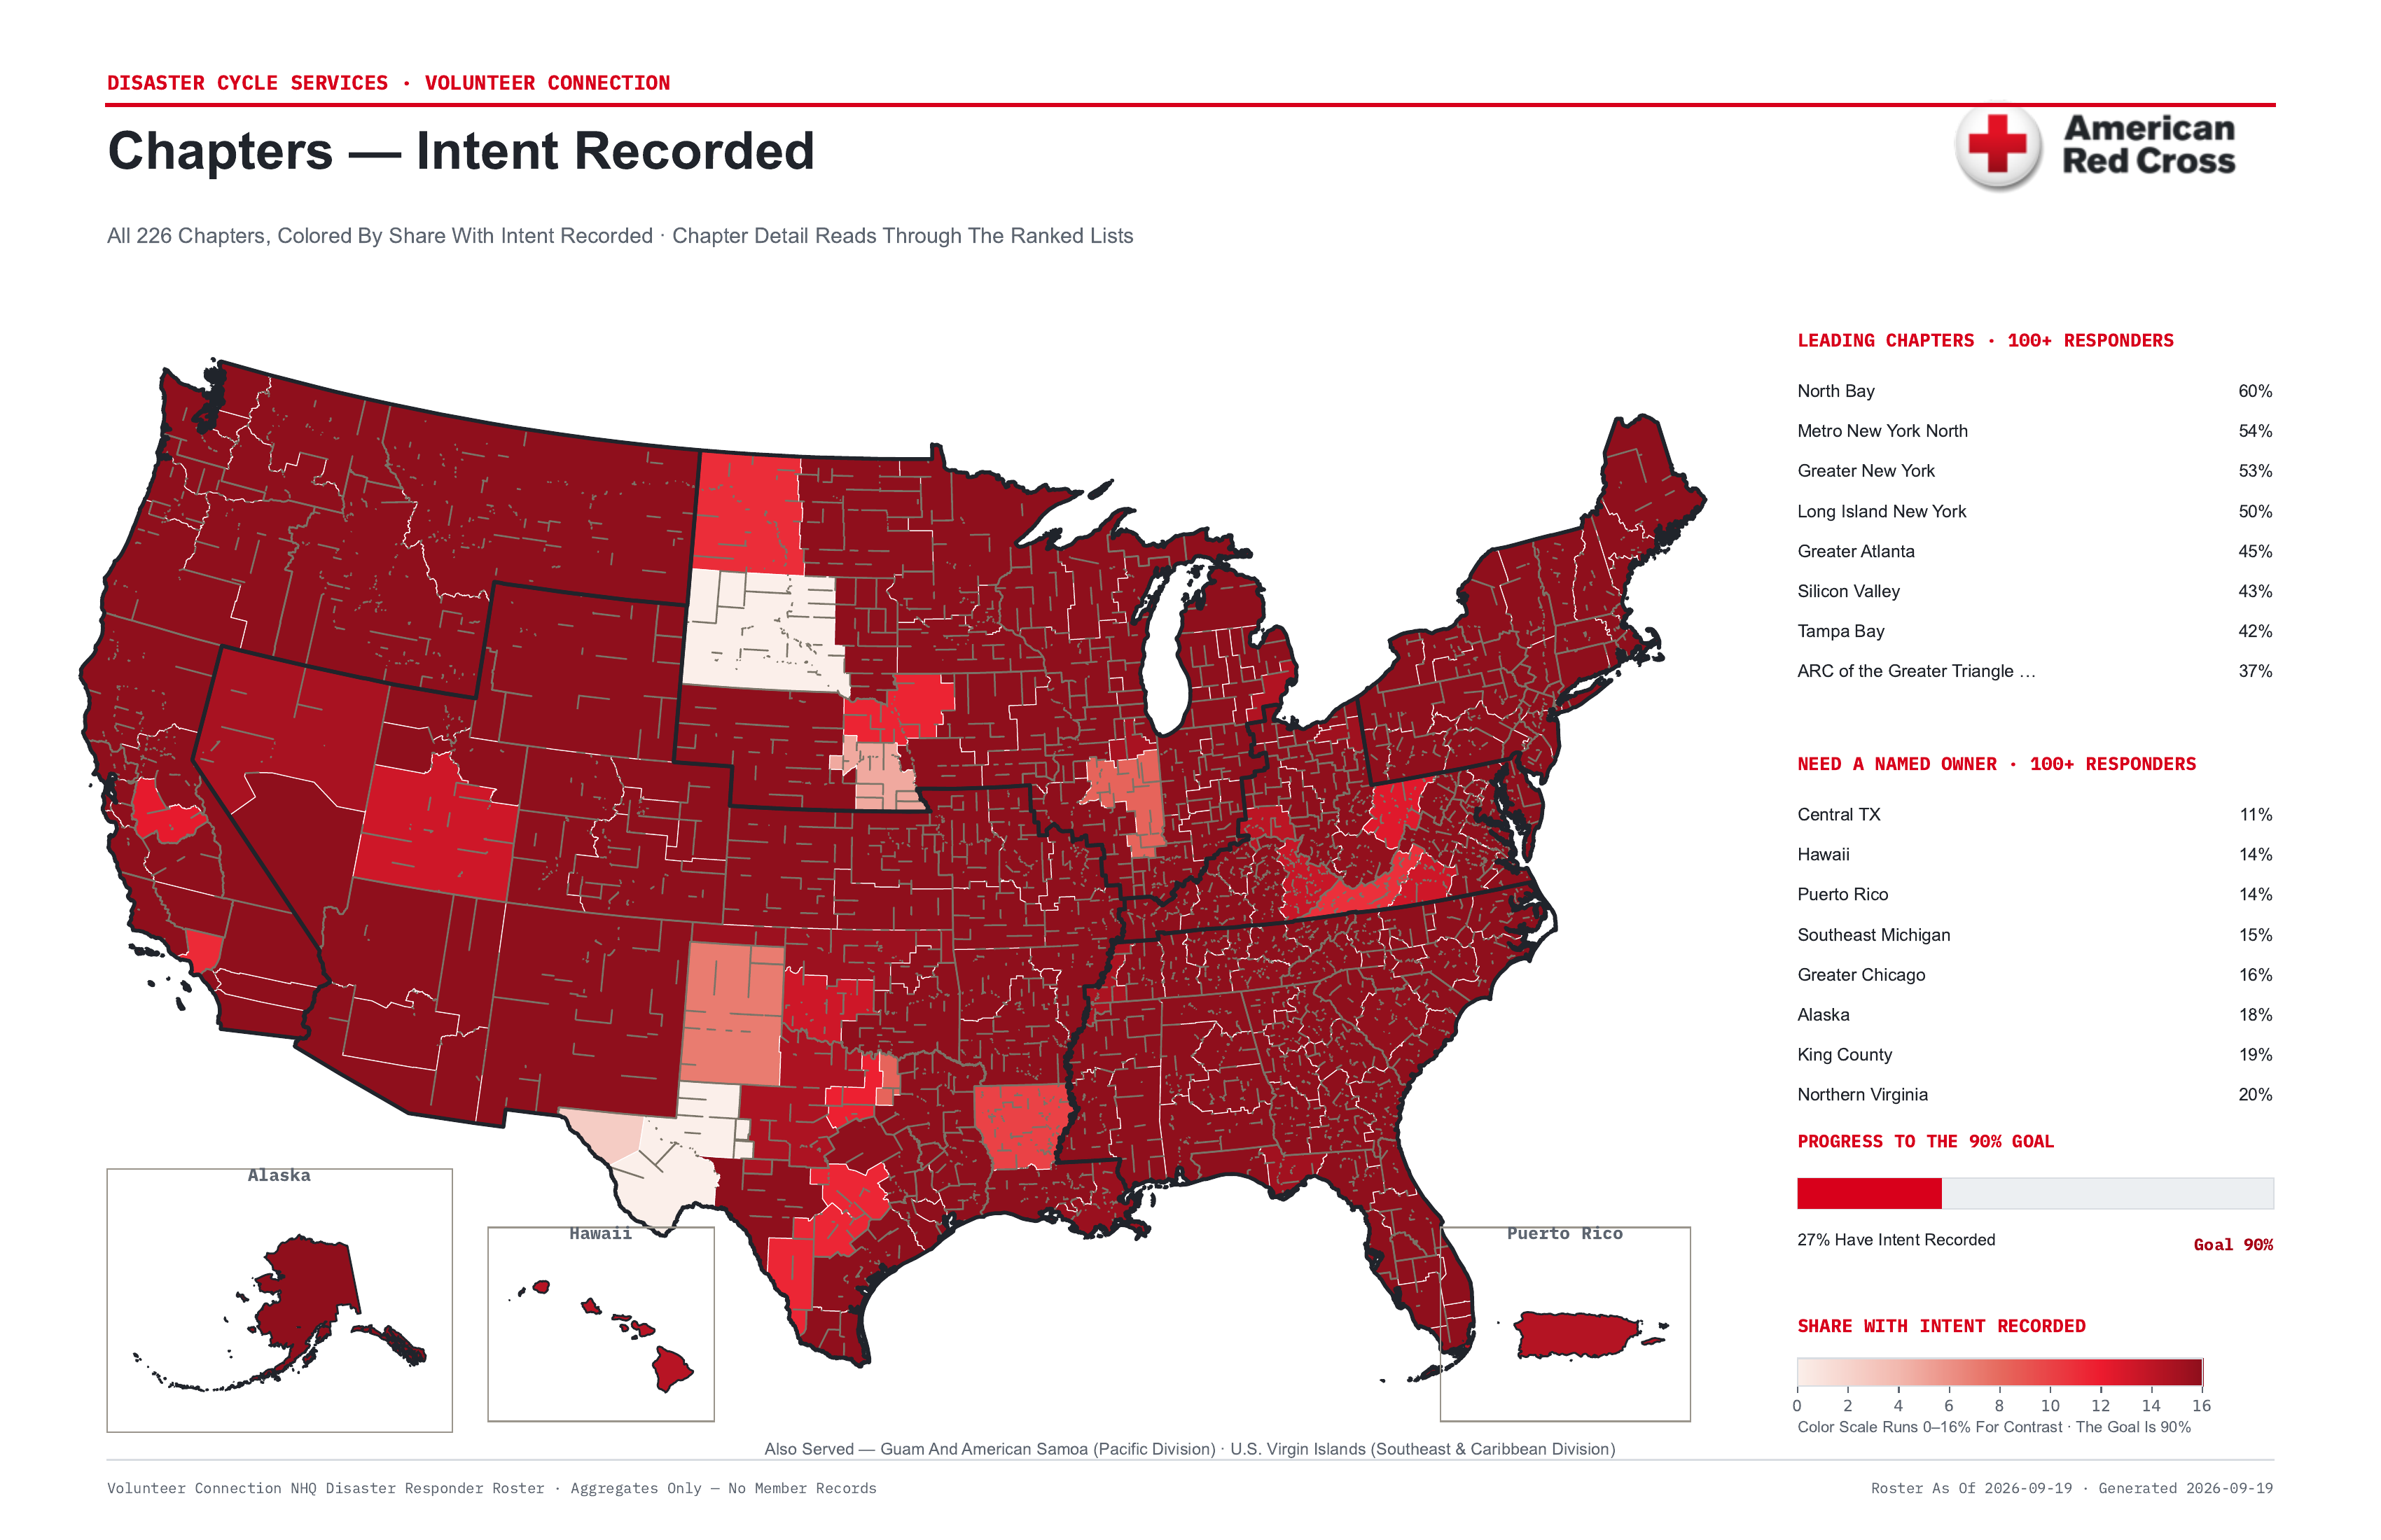
Chapters
Notes:
Chapter level, the finest geography the roster supports. Use this to find the specific chapters inside a struggling region rather than treating the whole region as uniformly behind. Most regions contain both leaders and laggards.

Slide 5
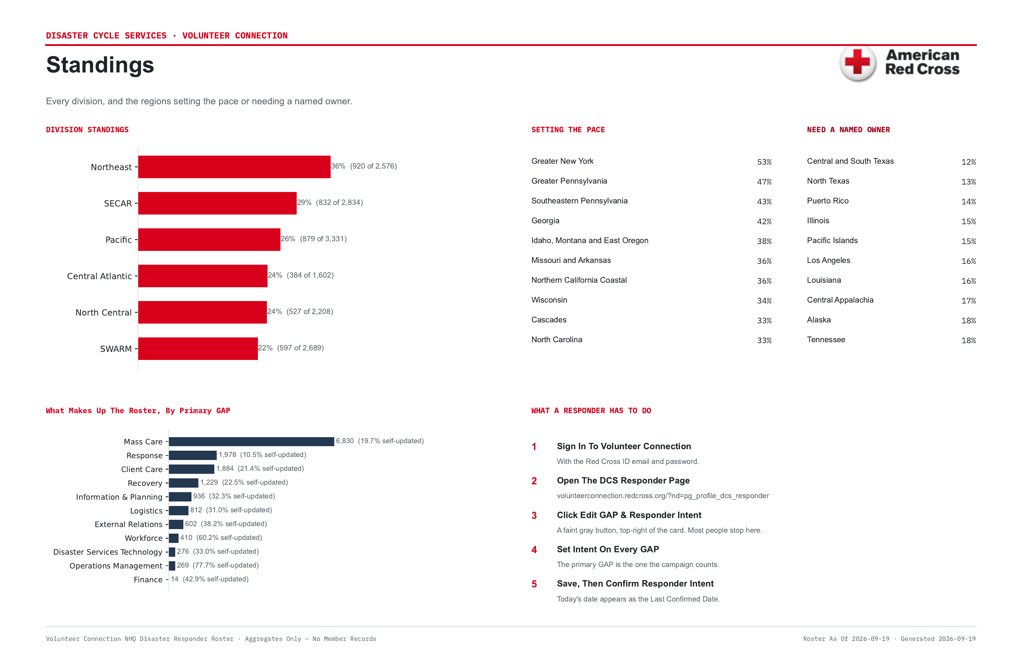
What It Takes To Move A Number
Notes:
Standings, and the four steps a responder has to complete. Step three is where almost everyone stops — the Edit button is faint gray and easy to miss. Anyone briefing their region should walk their people to step four specifically, not just tell them to update their intent.

